Slide 1

Capstone Project
Play Store App Review Analysis

Slide 2

Content:
Problem Statement
Why Google Play Store and it’s data?
EDA and process involved
Data Understanding
Data Cleaning and Manipulations
Correlation Heatmaps
Exploratory Data Analysis(EDA):
Bivariate Analysis
App Categories
App Price
App Ratings
App Installs
App Revenue
Sentiments
Challenges faced during data exploration
Conclusions of our analysis
Predictions

Slide 3
Problem Statement:
The Play Store apps data has enormous potential to drive app-making businesses to success. Actionable insights can be drawn for developers to work on and capture the Android market.
Each app has values for category, rating, size, and more. Another dataset contains customer reviews of the android apps.
Our main objective is to perform EDA on the given dataset to discover key factors responsible for app engagement and success.
We need to analyze the data and come up with meaningful insights that would actually help business to strategize their moves.

Slide 4
Why Google Play Data is important to analyze??
In 2021, the Google Play Store had 70% of worldwide downloads throughout the whole year.
As a large section of apps are free, people tend to download them from Google Play Store.
Mobile app market is set to grow 20% by 2023.
It offers a ready-made market for apps and games. They have a capacity of about a little over 2 billion users monthly!!
Knowing the important insights from the play store data can help developers and business managers because they can predict the profit and manage their revenues accordingly.
So, let’s get started!!

Slide 5
Exploring our databases:
We have 2 databases: Play store data set + User reviews data set
Play store data set : It contains basic details of the app like number of users, reviews, ratings, etc. It has 10841 rows and 13 columns. The features of play store data are:
App: It contains name of the app with short description.
Category: This column give the category to which an app belongs. This data set contains 33 categories.
Rating: The average rating given by the users for the respective app.
Reviews: The number of users that have dropped a review for this respective app.
Size: The disk space required to install the respective app.

Slide 6
Exploring our databases continued..
Installs: The approximate number of times the respective app was installed
Type: It states whether an app is free to use or paid.
Price: It gives the price payable to install the app. Price is 0 for free app.
Content Rating: It states which age group is suitable to consume the content of the respective app.
Genres: It gives the genres to which respective app belongs.
Last Updated: It gives the date at which the latest update for the respective app was released.
Current Ver: It gives the current version of the respective app.
Android Ver: It gives the android version of the respective app.

Slide 7
Exploring our databases continued..
User reviews data set : It contains the user reviews and its sentiment score for the respective app.
It has 64295 rows and 5 columns.
App: It contains name of the app with short description.
Translated Review: It contains the English translation of the review dropped by the user of the app.
Sentiment: It gives the attitude/emotion of the writer. It can be ‘Positive’ , ‘Negative’ or ‘Neutral’.
Sentiment Polarity: It gives the polarity of the review. Its range is [-1,1], where 1 means ‘Positive statement’ and -1 means a ‘Negative statement’.
Sentiment Subjectivity: This value gives how reviewer’ s opinion is to the opinion of the general public. Its range is [0,1].

Slide 8

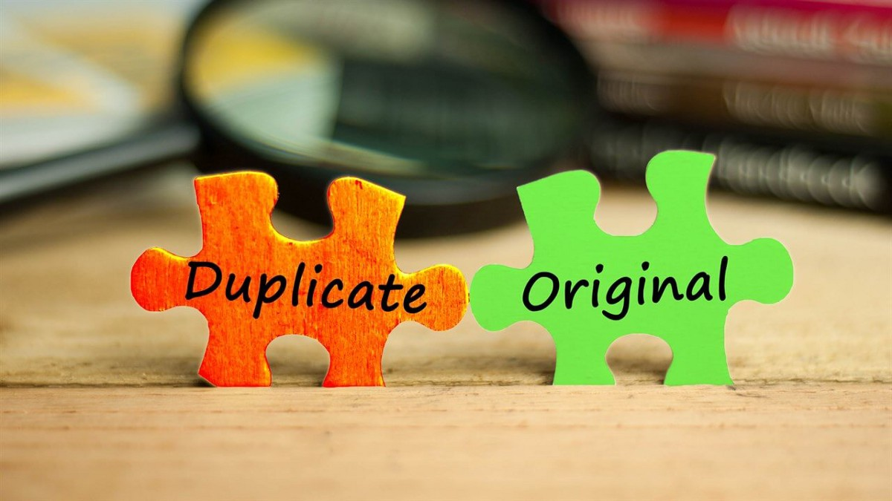


Dealing with Duplicate Values in Play Store Data

Slide 9
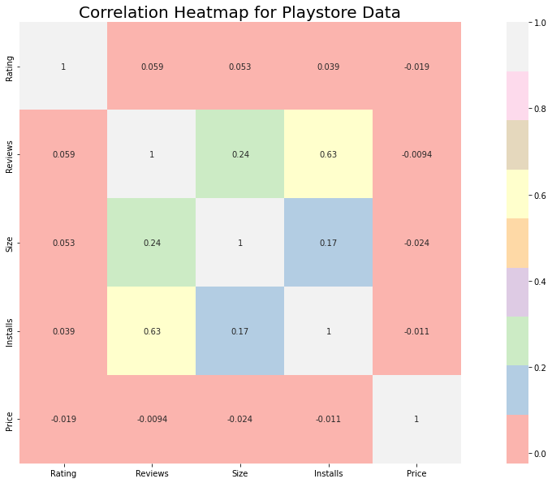
How Size, Reviews, Installs and Price of apps are correlated?
Positive correlation between the Reviews and Installs column i.e. (0.63).
While Price and Ratings share negative correlation i.e. -0.019.

Slide 10
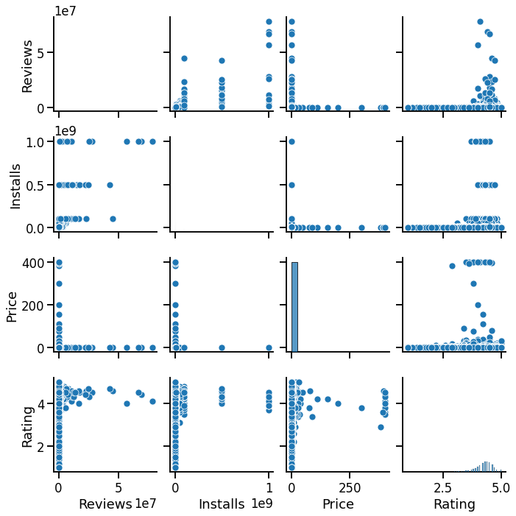
Bivariate Analysis
Here, we are exploring 2 columns at the same time, for the purpose of determining the empirical relationship between them.

Slide 11
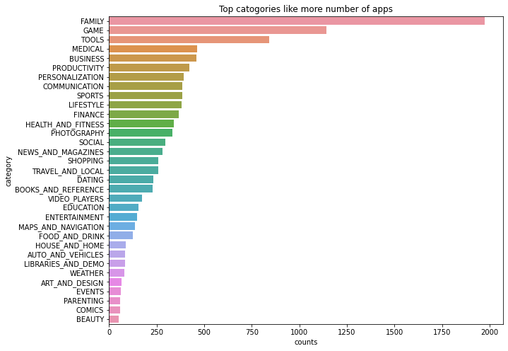
Let’s explore app categories!
Most of the apps are under FAMILY & GAME category and least are of Comics & BEAUTY Category.

Slide 12
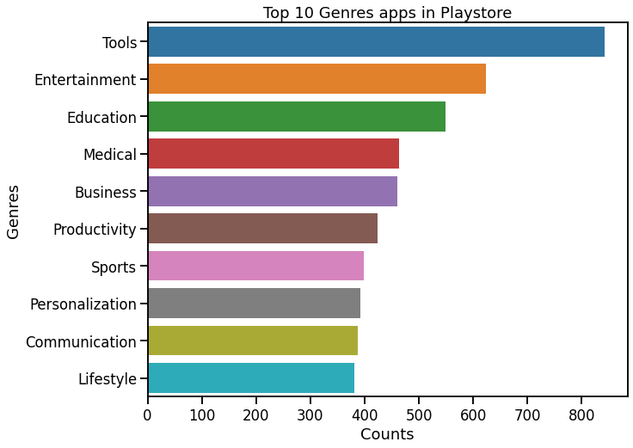
Now look what are the top Genres in the playstore

Slide 13
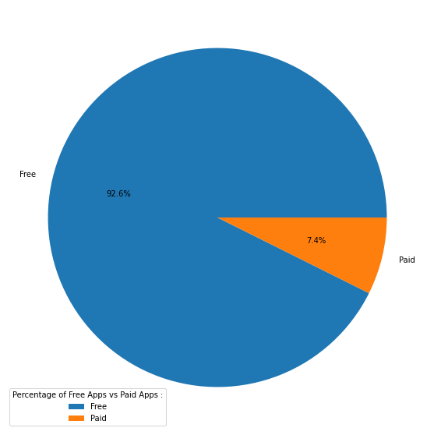
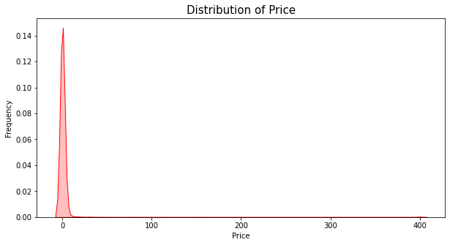
How many apps are paid?
From the above pie chart, we can conclude 92.6% apps on google play store are free.
Even from the 7.4% of paid apps, most of the apps has price range under 100 dollars.
So less the price
More are the installs!!

Slide 14
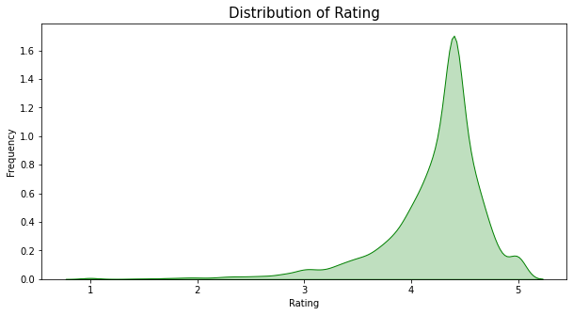
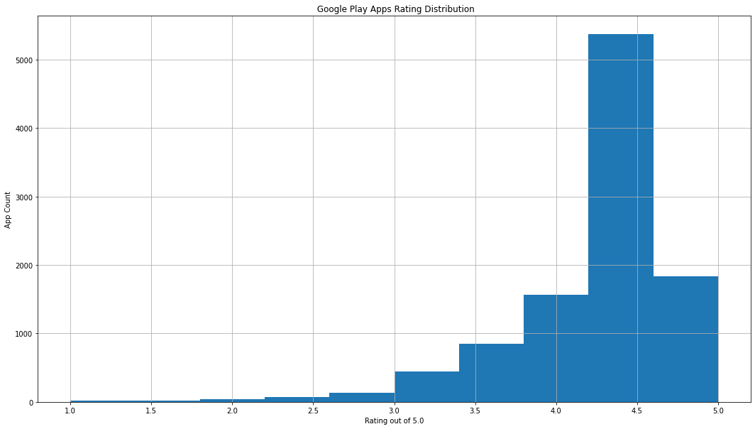
Now let’s see how ratings are performing!
We can observe that average rating across all app categories is 4.217.
A small spike at rating 1 emphasizes that a few apps has been rated poorly and hence the subsequent installs are affected.

Slide 15
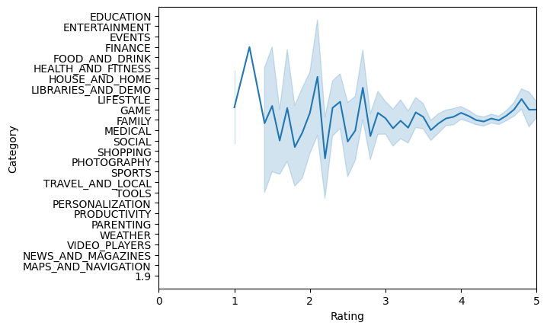
Comparing the rating with category
In the graph the rating
is almost the same path
game s and family has the 5
star rating the compared to
other categories
other category can make
the app with low rating

Slide 16
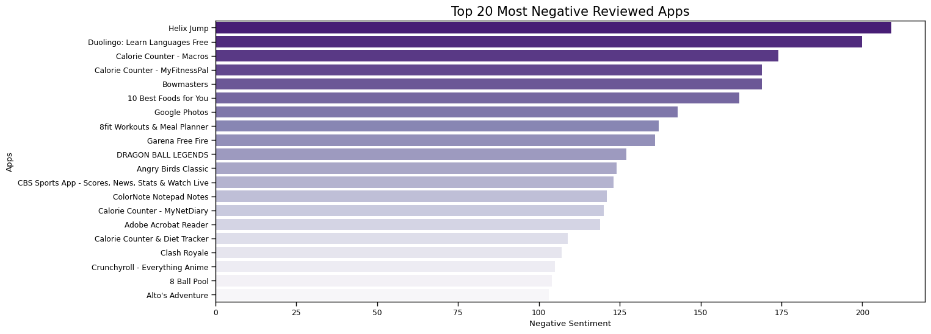

Let’s explore content rating!
**Candy Crush Saga** is the most negatively reviewed app on
Play store followed by **8 Ball Pool**, **Angry Birds Classic** and others...

Slide 17
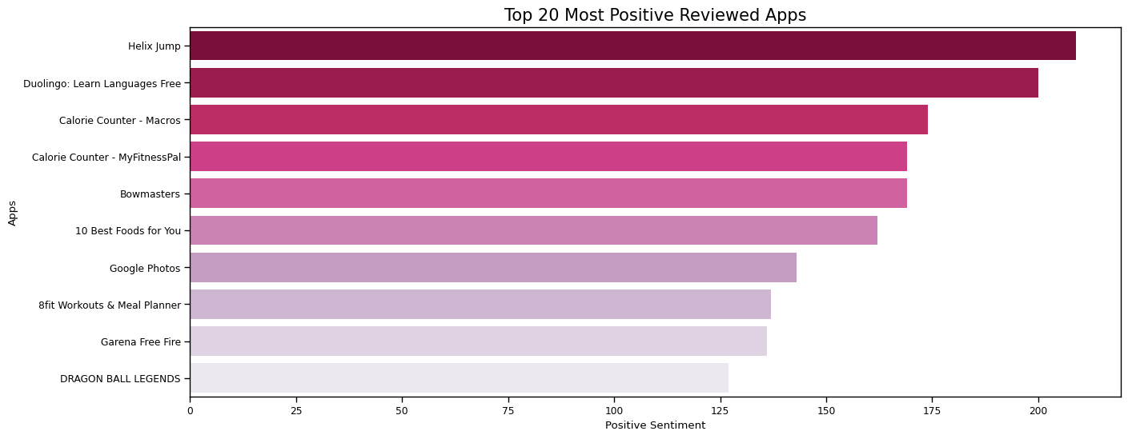
7 TOP 10 Apps** with the most number of **Positive Reviews** *italicized text
Duolingo: Learn Languages Free** is the **Most Positive Reviewed** app in playstore followed by **Helix Jump**, **Bowmasters** and others

Slide 18
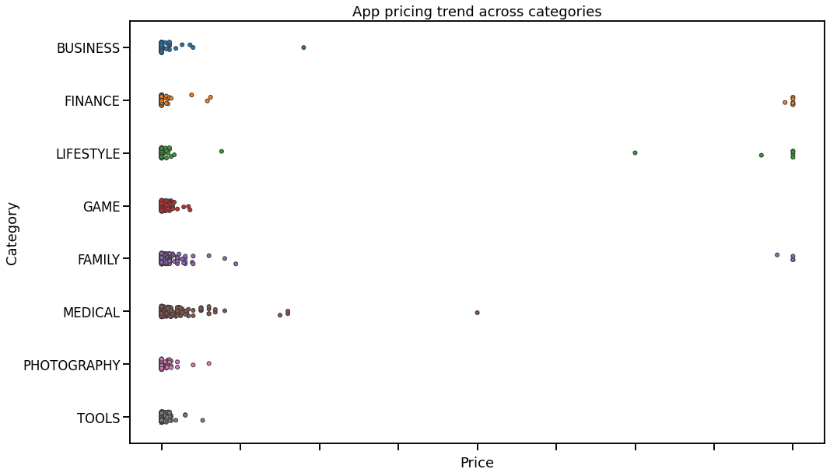
Relationship between app category and app price Section
Many factors to be consider when selecting the right pricing strategy for your mobile app. It is important to re-evaluate the app price before entering the market.Is it worth the pice or not?.
Here we can see that Different categories apps demand different price ranges. Some apps that are simple and easy are free, where as apps in category family lifestyle finance and medical are high in price.

Slide 19
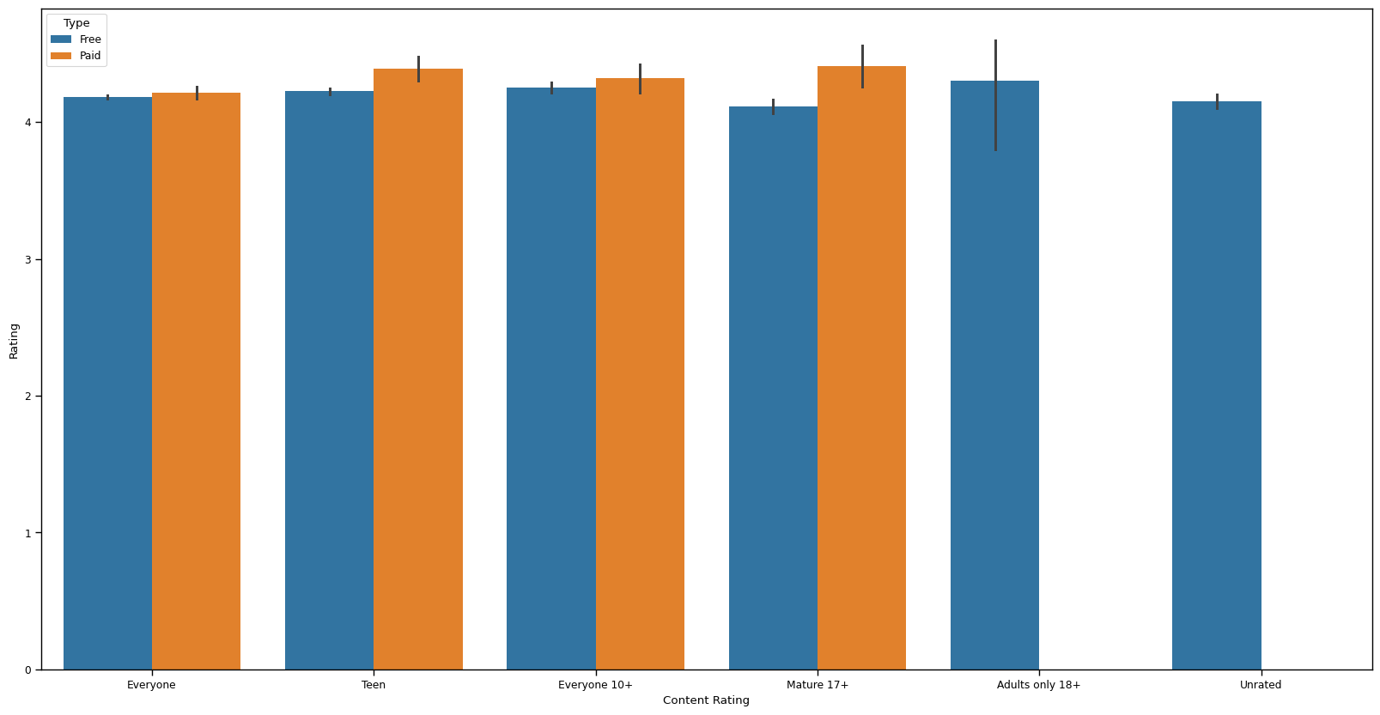
9.Comparing content rating and app rating with the type
here by the graph we have seen that CONTENT RATING WITH 'EVERYONE','TEEN','EVERYONE 10+'AND'MATURE 17+' has the same overall same rating with free and paid
As we compared with the other 'adult only 18+' and 'unrated' has no paid apps

Slide 20
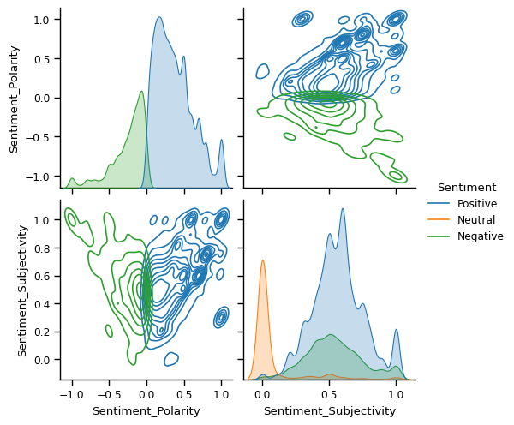
10 visualizing the pair plot for better understanding

Slide 21
So let’s talk about the challenges that we faced:
One of the major challenge was to clean the datasets as a lot of scattered information was present especially in the 1st data set.
Handling the error, duplicate and NaN values in the dataset.
To draw meaningful insights, we had to design multiple visualizations like scatterplot, jointplot etc. without compromising the results and trends.
To overcome above challenges, we followed:
AlmaBetter Class material
Pandas and Numpy libraries
Stack overflow
YouTube
GeeksforGeeks
Analytics Vidhya

Slide 22
Conclusions:
Reviews and Installs share positive correlation while Price and Rating share negative correlation.
Games has the most number of installs and hence is a potential unsaturated space for all developers, as it has a maximum number of installs.
Developing apps within Family and Lifestyle categories can be aimed for more profit i.e. high revenue .
61% of people have positive sentiments while approx. 15% reacted negatively sentiments.
Compared with Free and paid apps, 92.12% apps are Free and 7.81% apps are Paid.
As Everyone content rating contains all age group people , it has maximum i.e. 81.80% apps.
Maximum number of apps belong to the Family , Game and Tools category.
People love to download apps from Tools , Entertainment , Education , Business and medical genres.
Average rating of apps on the play store is 4.17 which is quite good.
Users prefer to pay for apps that are Light weighted and Free.
Paid apps that are higher in Size and Price are not performing well in the market.
Users tend to download a given app more if it has been reviewed by a large number of people.
There is a positive correlation between Installs and Rating.

Slide 23
Let’s do some predictions!
Now that we have analyzed out datasets and drawn meaningful insights out of them, let’s see if we can ‘predict’ a perfect app!!
It's good to develop a free app that consumes less disk space and family and lifestyle categories can be aimed for more profit.
People tend to download more if apps have more reviews.
People follow apps with regular updates.
The category GAME is a potential unsaturated space for app developers. The segment is expected to grow 1.7 times faster than the rest of the market and surpass $136 billion in revenues in 2022.

Slide 24
THANK YOU

